Slide 1

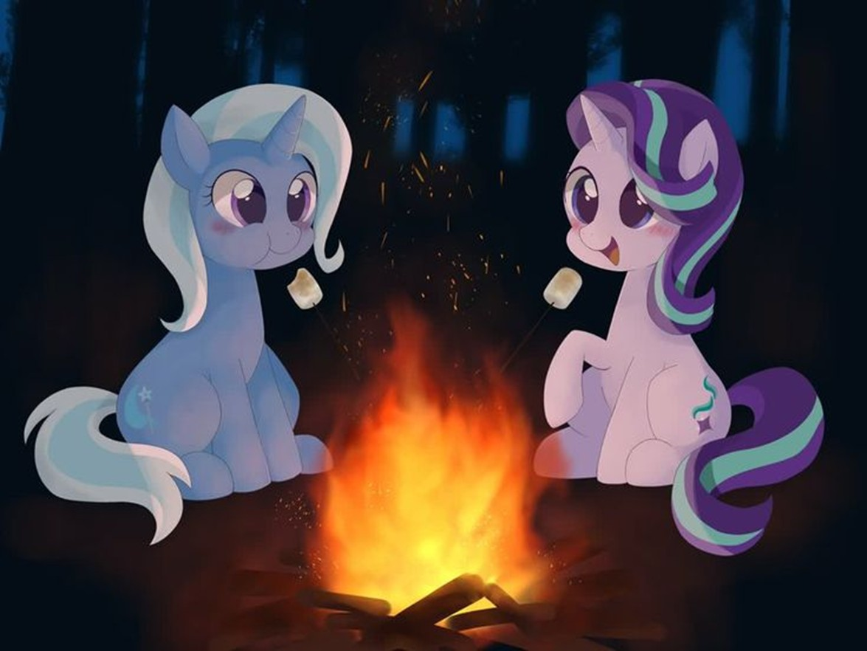
GLOSSOP & DISTRICT PONY CLUB
WINTER SOLSTICE BONFIRE PARTY
Saturday 13th December 18:00
At Hollys (Elizabeth Ash Farm, Chinley. SK23 6AL
FREE!!!
Join us for an evening of bonfire fun and games, food and have a go at shooting practice!

