Slide 1
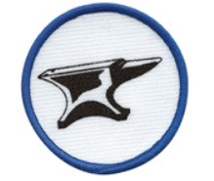
Pony Club Achievement badge: Shoeing

Slide 2
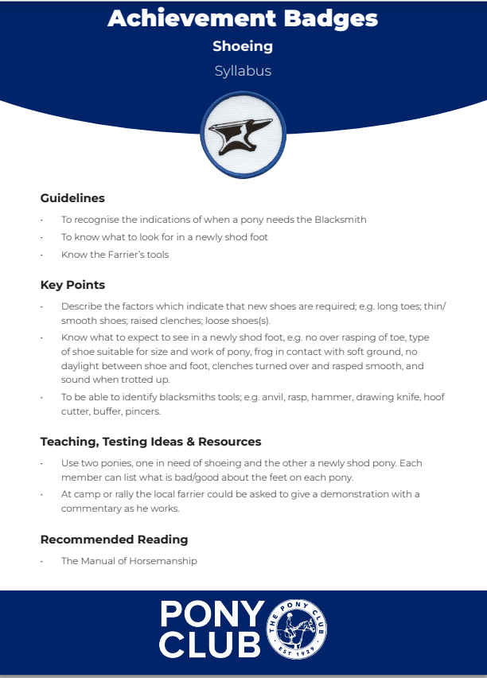

Slide 3
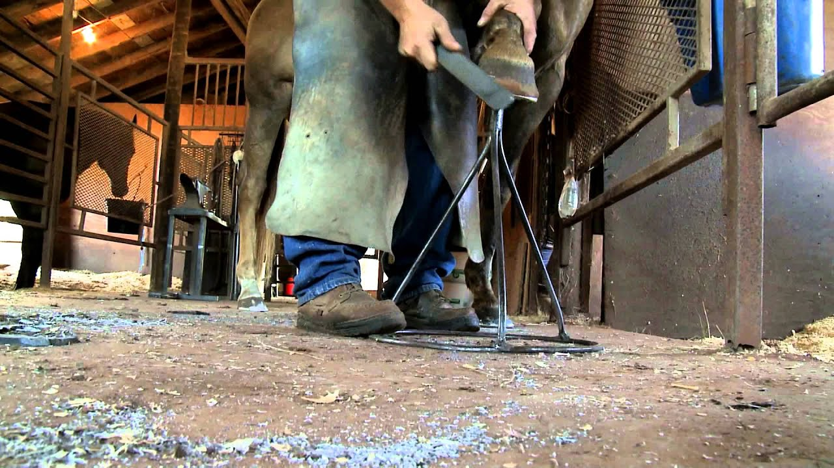
When do horses need new shoes? (Click on the link below and it will take you to a ‘You tube video’)
https://www.youtube.com/watch?v=3Y8dUut3BFU

Slide 4
Things to look for in a newly shod foot
In a newly shod foot you would expect to see -
1 No over rasping of toe,
2 Type of shoe suitable for size and work of pony,
3 Frog in contact with soft ground,
4 No daylight between shoe and foot,
4 Nails in symmetrical curve,
5 Shoe fitting the hoof, (not hoof cut to fit shoe).
6 Open heels,
7 Correct length.
8 Clenches turned over and rasped smooth,
9 Sound when trotted up.
11 A smooth filed wall surface
12 Fresh nail holes

Slide 5
Which leg is which?
Everyday name | Correct term (used by farriers and vets)
Left front | Nearside fore
Left back | Nearside hind
Right front | Offside fore
Right back | Offside hind

Slide 6
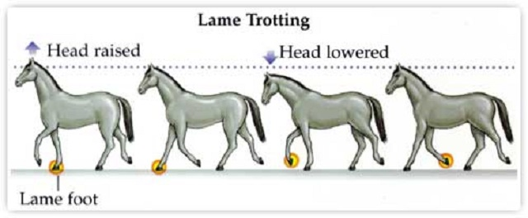
Occasionally a nail can prick the sensitive laminae. Most of the time the farrier will realize that this has happened straight away. This is known as nail prick. If the nail has been placed too close to the sensitive laminae, but hasn't actually contacted the laminae this is known as nail bind.

Slide 7
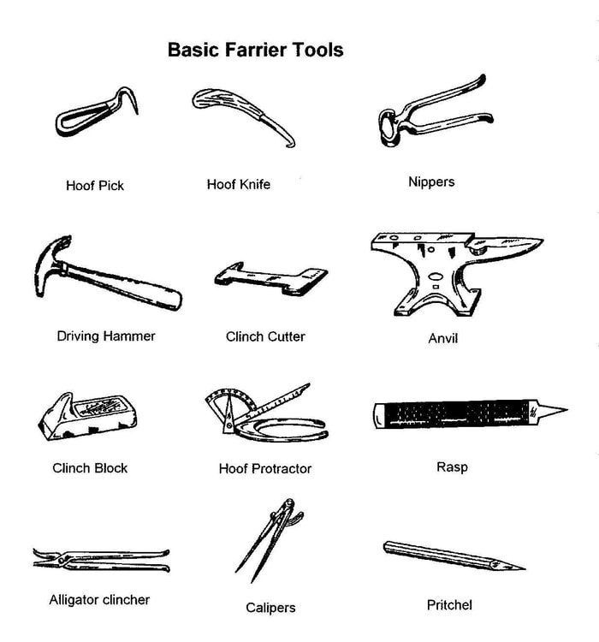
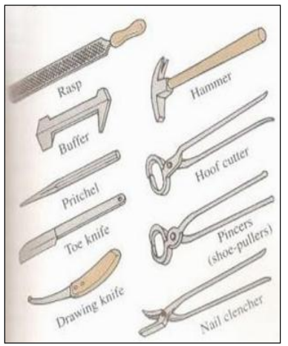

(hoof cutters)
(drawing knife)
(Buffer)
Rounding hammer for shaping shoe

Slide 8
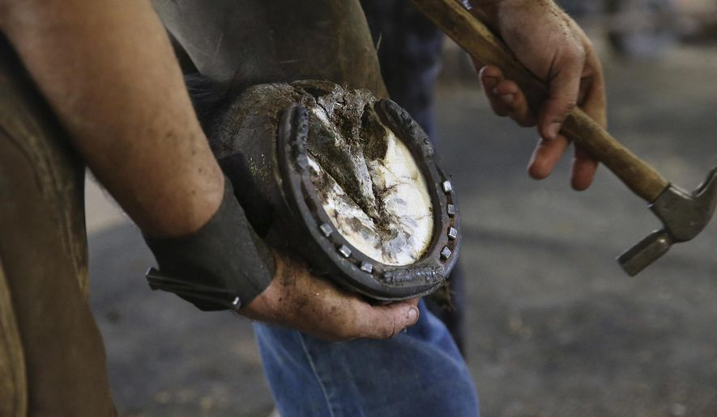
Now watch this video of a pony being shod Use the pictures of tools on page 6 (maybe you could print it out?) to help you name each tool as the farrier uses it
https://www.youtube.com/watch?v=A8y8BoQ_k4Q

